Slide 1

Intercom AI Chatbot

Slide 2
What’s Intercom?
Conversational Relationship platform with online customers
Powerful automation technology powers our bots for sales, and support, amplifying the impact of the team and automating simple actions like recommending help content to resolve queries
Onboard and support your customers with the team you already have.
Intercom puts your customer messaging in one place.
Intercom is one of the most well-known customer support tools on the market
Intercom offers one of the most comprehensive sets of tools for a modern business to cover its customer service needs.

Slide 3
Intercom Current Features
Intercom is a great comprehensive tool offering
Live chat.
Help desk.
Email automation features.
Custom Bots.
Create the perfect bot that helps you crush your number, qualify more leads and book more meetings around the clock.
Onboard and activate customers with targeted outbound engagement.
Improve retention rates, share product announcements, and onboard with ease—all in your mobile app.
Automatically route conversations with custom bots.
Instantly answer your customers’ common questions with Resolution Bot.
Rely on saved replies to keep your team in the loop and up to date.
Customizing your Messenger ensures it looks right at home on your app or site. Learn how to:
Customize the experience for your users, leads and visitors.
Set the controls for your workspace.
Track user data
Forward your emails and social messages
Design an inbound Custom Bot
Create ongoing messages
Faster customer resolutions
Notes:
Intercom is a great comprehensive tool offering live chat, help desk, knowledge base, and email automation features. It’s also quite famous for its well-developed chatbots and convenient product tours for customer onboarding.
Introduction to Custom Bots
Create the perfect bot that helps you crush your number, qualify more leads and book more meetings around the clock.
Onboard and activate customers with targeted outbound engagement.
Use Product Tours to create a series of onboarding steps or to announce a new feature.
Create targeted messages and campaigns to deliver the right message to the right customer.
Mobile Carousels ?
Improve retention rates, share product announcements, and onboard with ease—all in your mobile app.
If you're experiencing a spike in customer conversations right now, Intercom can help. Learn how to:
Highlight timely FAQ content with the Content Showcase app.
Automatically route conversations with custom bots.
Instantly answer your customers’ common questions with Resolution Bot.
Rely on saved replies to keep your team in the loop and up to date.
Customizing your Messenger ensures it looks right at home on your app or site. Learn how to:
Customize the experience for your users, leads and visitors.
Set the controls for your workspace.
Track user data
Track user data to see who your customers are and what actions they take in your app. Filter, segment, and reach out to your customers using information tailored to your business.
Forward your emails and social messages
Automatically send emails and social media channels to teams or teammates in Intercom so you can handle all support requests from your team inbox.
Design an inbound Custom Bot
Create ongoing messages
With ongoing messages, you can create messages that send to those who match your filters now and in the future. Just choose:
Your message type,
Who your audience is,
When you want it to send and
How do you want to measure performance?
Faster customer resolutions
Custom Bots ask the right questions to automatically prioritize and route new conversations for more efficient support.
Complete customization
Chatbots connect to your tech stack, automate workflows behind the scenes, and act as extensions of your sales and support teams.
More leads, 24/7
Bots work for you all day, every day—starting conversations, asking questions, and delivering qualified leads when they're live on your site.
24/7 automated support with Resolution Bot
Complete self-service: Our chatbot uses machine learning to accelerate resolution times for your customers—even if your team is busy or offline.
Easy-to-train automation: Resolution Bot automatically recognizes similar questions from past conversations to serve up the answer you deem best.
Goodbye repetitive work: Let our chatbot respond to questions that get asked over and over, so your team can focus on more productive tasks.
Use it as soon as customers start typing: Speed up self-service by offering relevant answers based on what customers are typing—before they even hit the enter key.
Bots in different languages and time zone: Make 24/7 global support easier for your team by automating answers in 32 languages. Your team doesn’t have to be online for our bots to start conversations, route qualified leads, and collect customer info for you.
Code-free and hassle-free chatbots: Build a bot in minutes that lightens your team's workload—collecting information, triaging conversations, or even answering questions.
Improve how your business operates: Whether you use our out-of-the-box reports, customize your own, or use our APIs and apps, you can measure exactly what’s important to your business with maximum flexibility.

Slide 4
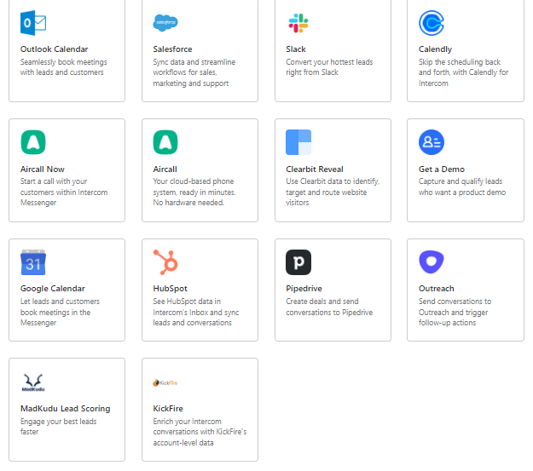
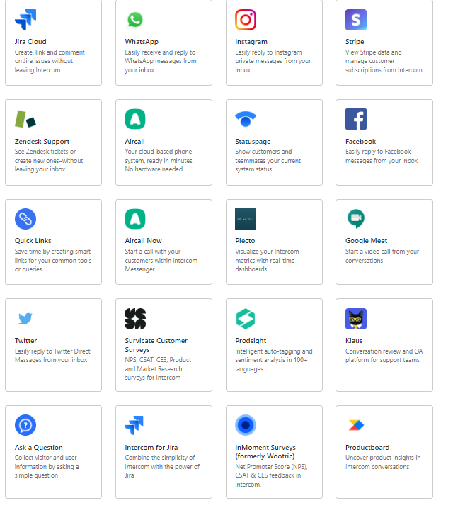
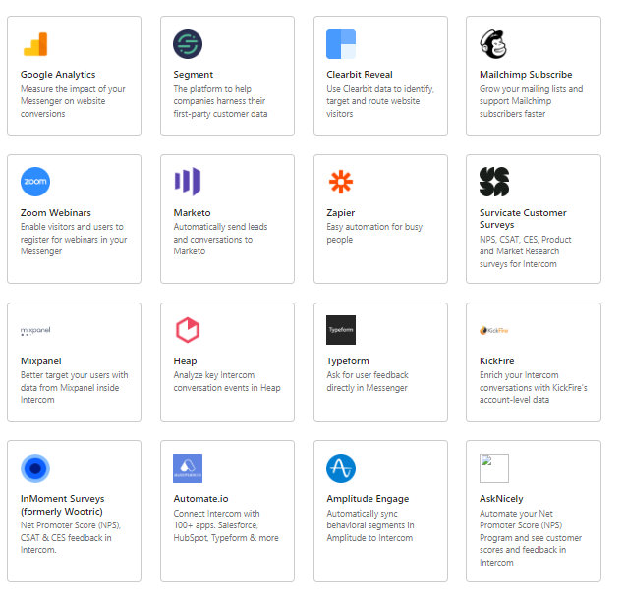
Apps & Integration
Notes:
Intercom is a great comprehensive tool offering live chat, help desk, knowledge base, and email automation features. It’s also quite famous for its well-developed chatbots and convenient product tours for customer onboarding.
Introduction to Custom Bots
Create the perfect bot that helps you crush your number, qualify more leads and book more meetings around the clock.
Onboard and activate customers with targeted outbound engagement.
Use Product Tours to create a series of onboarding steps or to announce a new feature.
Create targeted messages and campaigns to deliver the right message to the right customer.
Mobile Carousels ?
Improve retention rates, share product announcements, and onboard with ease—all in your mobile app.
If you're experiencing a spike in customer conversations right now, Intercom can help. Learn how to:
Highlight timely FAQ content with the Content Showcase app.
Automatically route conversations with custom bots.
Instantly answer your customers’ common questions with Resolution Bot.
Rely on saved replies to keep your team in the loop and up to date.
Customizing your Messenger ensures it looks right at home on your app or site. Learn how to:
Customize the experience for your users, leads and visitors.
Set the controls for your workspace.
Track user data
Track user data to see who your customers are and what actions they take in your app. Filter, segment, and reach out to your customers using information tailored to your business.
Forward your emails and social messages
Automatically send emails and social media channels to teams or teammates in Intercom so you can handle all support requests from your team inbox.
Design an inbound Custom Bot
Create ongoing messages
With ongoing messages, you can create messages that send to those who match your filters now and in the future. Just choose:
Your message type,
Who your audience is,
When you want it to send and
How do you want to measure performance?
Faster customer resolutions
Custom Bots ask the right questions to automatically prioritize and route new conversations for more efficient support.
Complete customization
Chatbots connect to your tech stack, automate workflows behind the scenes, and act as extensions of your sales and support teams.
More leads, 24/7
Bots work for you all day, every day—starting conversations, asking questions, and delivering qualified leads when they're live on your site.
24/7 automated support with Resolution Bot
Complete self-service: Our chatbot uses machine learning to accelerate resolution times for your customers—even if your team is busy or offline.
Easy-to-train automation: Resolution Bot automatically recognizes similar questions from past conversations to serve up the answer you deem best.
Goodbye repetitive work: Let our chatbot respond to questions that get asked over and over, so your team can focus on more productive tasks.
Use it as soon as customers start typing: Speed up self-service by offering relevant answers based on what customers are typing—before they even hit the enter key.
Bots in different languages and time zone: Make 24/7 global support easier for your team by automating answers in 32 languages. Your team doesn’t have to be online for our bots to start conversations, route qualified leads, and collect customer info for you.
Code-free and hassle-free chatbots: Build a bot in minutes that lightens your team's workload—collecting information, triaging conversations, or even answering questions.
Improve how your business operates: Whether you use our out-of-the-box reports, customize your own, or use our APIs and apps, you can measure exactly what’s important to your business with maximum flexibility.

Slide 5



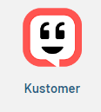



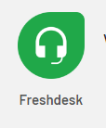


Intercom Competitors
Intercom competitors for support, marketing, and sales: HelpCrunch, Crisp, Help Scout.
Intercom competitors for live chat: Olark, LiveChat, Smartsupp, GoSquared.
Support-oriented Intercom competitors: Zendesk, Freshworks, LiveAgent, Lemtalk.
Marketing- and sales-oriented Intercom competitors: Drift, Customerly.
Notes:
https://www.g2.com/products/intercom/competitors/alternatives

Slide 6
Current Problems
Challenges
The pricing system is way too complex to predict ,and very high range pricing Intercom pricing consists of several elements
Lack of support (support must be 24/7)
Overpricing product not suitable for small company .
Customer support, overpriced product, low customisation abilities, not suitable for enterprise scale
Need to integrate with AI Chatbot for Increasing the demand for self-service
24/7 Availability
Instant Response
Relevant and quick responses are delivered to the customer.
Increase User Engagement.
Set Pricing plans covered all company size.

Slide 7
Solutions
It should have a clear and transparent pricing policy that is easy to predict and scale.
It should provide a stable and reliable experience, with a customer support team that’s always happy to help.
AI chatbots are the best available solution for businesses for increasing user engagement , Service More Customers at the same time without any cost besides it can gather data and create details reports on customer behavior and preference for improving the service and Get the Best Customer Experience

Slide 8
AI Chatbot Suggested features
All site features should be accessible through chatbot AI.
According to the user journey, the user has two options (AI chatbot and live agent).
At the end of each customer conversation, collect customer feedback via an AI chatbot.
Obtain a Net Promoter Score (NPS) based on chatbot usage by customers ( at least 5 times per month).
Customers can evaluate product features using an AI Chatbot.
Customers can request a demo from the AI chatbot.
Display the number of conversations conducted via AI chatbot for customers to validate the effectiveness the value of using AI chatbot and to increase user engagement.
Using ML emotion recognition, an AI chatbot can recognize emotions.
Apply voice Recognition.
improve utterances of user journey based on BI.
Reduce user waiting time to less than 30 seconds .

Slide 9
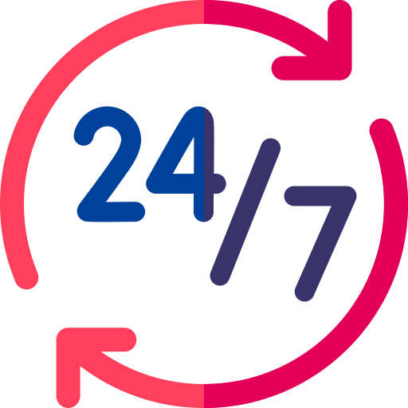






Benefits of Using AI Chatbot
24/7 Availability
Instant Response
Consistency in Answers
Relevant & quick responses
Enriching the user experience
Multilingual
Deliver consistent responses
Notes:
24/7 Availability – Customers needn’t wait for the next available operator when chatbots are part of the communication strategy on a round-the-clock basis.
Instant Response – Chatbots can handle the queries of thousands of customers instantly as well as simultaneously and improve the average response time.
Consistency in Answers – The use of chatbots can help businesses maintain a great level of consistency in answers and improve customer experience with the product features
Enriching the user experience – can ensure a touch of personalization by engaging customers with one-on-one conversations, maintaining a natural-sounding tone, and by being good at interactive communication.
Multilingual – Your business can program the sales bot to answer queries in the language of customers
Deliver consistent responses to avoid providing irrelevant information to customers.
Relevant and quick responses are delivered to the customer.
One-on-one responses – Customers expect immediate one-on-one responses and you can use an AI chatbot to meet that goal

Slide 10
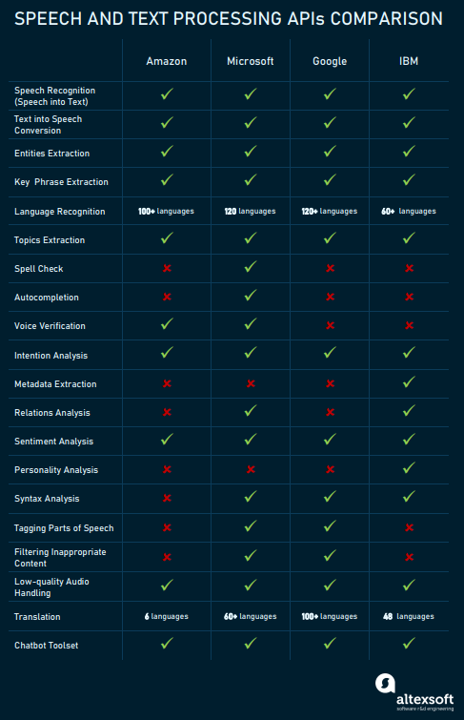
Proposed NLU Software for AI Chatbot
Amazon, Microsoft Azure (LUIS), Google Cloud AI, IBM Watson : are four leading cloud MLaaS (Machine learning as a service (MLaaS)services that allow for fast model training and deployment.
Recommend Using LUIS ( Language Understanding Intelligent Service) because : Simplicity ./ Security / Easy Integration
Notes:
Recommend Using LUIS ( Language Understanding Intelligent Service) because :
Simplicity . With only a few clicks you can build your own conversational AI application. You can build your custom application by following one of our quickstarts
Security, Privacy and Compliance: Backed by Azure infrastructure, LUIS offers enterprise-grade security, privacy, and compliance. Your data remains yours; you can delete your data at any time. Your data is encrypted while it’s in storage.
Integration: easily integrate your LUIS app with other Microsoft services

Slide 11
SRS
Feature Name: All site features should be accessible through chatbot AI.
ID | AIChatbot1.1
Priority
Description | As a customer, I want to use the chatbot to access any site features, I simply type any feature into the chatbot, and the chatbot directs me to the appropriate page. So that the chatbot navigates without searching.
Actors | Customer
Acceptance Criteria | A customer can access any site feature from the chatbot by typing the site feature and the chatbot navigates without searching. If a chatbot can’t determine a user's input, then we can display a list of suggestions that’s nearest to the user's input and show options for the user to get connected to a live agent and customer input is then saved for BI investigation (to check if customer’s input needs to be added to training data or not).
Definition of Done | Unit tests passed Acceptance criteria met Code review Passed: Functional tests passed Non-functional requirements are met.
Owner
Iteration | Unscheduled
Estimate | 5 points
1.1 All site features should be accessible through chatbot AI.

Slide 12
SRS
Feature Name: According to the user journey, the user has two options (AI chatbot and live agent).
ID | AIChatbo2.1
Priority
Description | As a customer, I want to be able to choose between speaking with a live customer support agent and continuing with the chatbot agent. So that chatbot directs based on the customer's responses.
Actors | Customer
Acceptance Criteria | If a customer could simply ask the chatbot to connect them to a human customer support agent, they could be talking to an agent in seconds. If not, the customer will proceed with the chatbot agent.
Definition of Done | Unit tests passed Acceptance criteria met Code review Passed: Functional tests passed Non-functional requirements are met.
Owner
Iteration | Unscheduled
Estimate | 3 points
2.1 According to the user journey, the user has two options (AI chatbot and live agent).

Slide 13
SRS
Feature Name: At the end of each customer conversation, gather customer feedback via an AI chatbot.
ID | AIChatbot3.1
Priority
Description | As a customer, I want to rate services and provide feedback whenever I finish a chat with a human agent or AI chatbot. So that the quality of service can be improved by time.
Actors | Customer
Acceptance Criteria | A customer can answer whether the support is effective or not. A customer can rate the speed of support whenever they finish a chat with a human agent or AI chatbot. If a customer has any suggestions for improving the service, he or she can leave a comment.
Definition of Done | Unit tests passed Acceptance criteria met Code review Passed: Functional tests passed Non-functional requirements are met.
Owner
Iteration | Unscheduled
Estimate | 3 points
3.1At the end of each customer conversation, gather customer feedback via an AI chatbot

Slide 14



Metrics & KPI to Measure Bot Success
The key metrics to evaluate in users side are as follows:
Total number of users :It helps you to capture insights on how many customers are using your chatbot. You also get to know the overall impact and chatbot success.
Engaged users :active users who have repeated conversations with your bot on a daily or weekly basis.
Number of new users :your potential targets and how your bot is helping them and they are ready to converse again.

Slide 15



Metrics & KPI to Measure Bot Success(Cont.)
The key metrics to evaluate in users side are as follows:
Chat volume: Evaluating chat volume refers to measuring the number of successful interactions made. It helps to understand more & more customers have started conversation. If the conversation is longer, it indicates a higher chat volume.
Goal completion rate (GCR): you can evaluate the success rate of a defined action performed through your chatbot. If your goal conversion rate is low, you should not jump to the conclusion that your bot is a failure.
Number of bot sessions : initiated measures the interactions sent and received between the users and your chatbot. It monitors and provides information on its ability to engage in a conversation.

Slide 16



Metrics & KPI to Measure Bot Success(Cont.)
The key metrics to evaluate in users side are as follows:
Fallback Rate (FBR) :bots are also not perfect. They fail at times to meet the defined goal. There are certain queries that bots do not understand. The fallback rate captures insights about those scenarios where the bot is not able to understand the user request and provide a relevant solution.
Customer satisfaction metrics : Customers are increasingly demanding real time communication. Businesses are making customer satisfaction their prime focus. By using CSAT & NPS surveys
Satisfaction score :The customer satisfaction KPI evaluates the user satisfaction level with bot conversation. At the end of the conversation, your chatbot can ask users a simple yes/no question about their experience

Slide 17
Wireframes
Available Here
Use Case Diagram
Available Here

Slide 18
References
https://www.intercom.com/resources/demos/intro-to-operator
https://www.intercom.com/resources/demos/intro-to-the-messenger
https://www.intercom.com/resources/demos/intro-to-custom-bots
https://www.intercom.com/resources/demos/mobile-carousels
https://www.intercom.com/resources/demos/what-is-intercom
https://www.intercom.com/resources/demos/tips-for-using-intercom-to-help-with-your-covid-19-response
https://www.intercom.com/resources/demos/intro-to-onboarding
https://www.intercom.com/resources/demos/customize-your-messenger
https://www.intercom.com/resources/demos/track-user-data
https://www.intercom.com/resources/demos/forward-your-emails-and-social-messages
https://www.intercom.com/resources/demos/design-an-inbound-custom-bot
https://www.intercom.com/resources/demos/create-an-ongoing-message
https://www.intercom.com/automated-answers?on_pageview_event=automated_answers_footer
https://helpcrunch.com/blog/intercom-competitors/
https://www.g2.com/products/intercom/competitors/alternatives
https://www.g2.com/compare/birdeye-vs-drift-vs-freshworks-freshchat-vs-zendesk-support-suite
https://www.g2.com/compare/drift-vs-intercom-vs-tidio-vs-zendesk-support-suite
https://www.g2.com/compare/drift-vs-intercom-vs-zendesk-support-suite-vs-mobilemonkey
https://www.gartner.com/reviews/market/social-customer-service-applications/vendor/intercom/reviews?marketSeoName=social-customer-service-applications&vendorSeoName=intercom&sort=-helpfulness
https://www.g2.com/categories/natural-language-understanding-nlu?utf8=%E2%9C%93&order=g2_score
https://www.altexsoft.com/blog/datascience/comparing-machine-learning-as-a-service-amazon-microsoft-azure-google-cloud-ai-ibm-watson/
https://yourtechdiet.com/blogs/best-ai-tools-in-market/
https://www.netguru.com/blog/ibm-watson-vs-google-cloud-vs-aws-vs-azure
https://docs.microsoft.com/en-us/azure/cognitive-services/luis/what-is-luis
https://www.luis.ai/
Notes:
More details : https://docs.google.com/document/d/1FcSx0Xk8FufTEr-VGQqKPQNRZCJ9q2I9yimF994fW48/edit?usp=sharing

